Slide 1
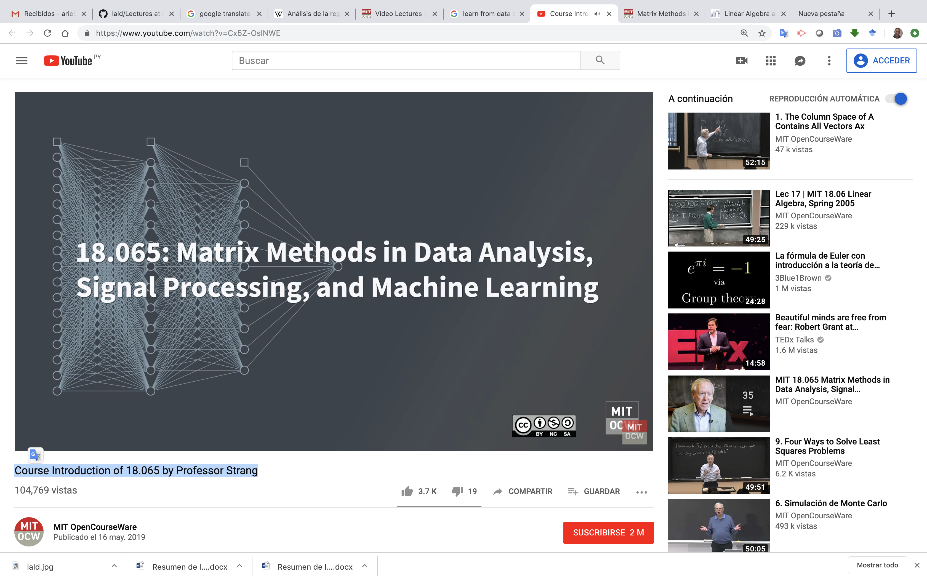
Matrix Methods in Data Analysis, Signal Processing, and Machine Learning
By Ariel Guerrero
ariel.guerrero@uc.edu.py
+595 (981) 425 040

Slide 2
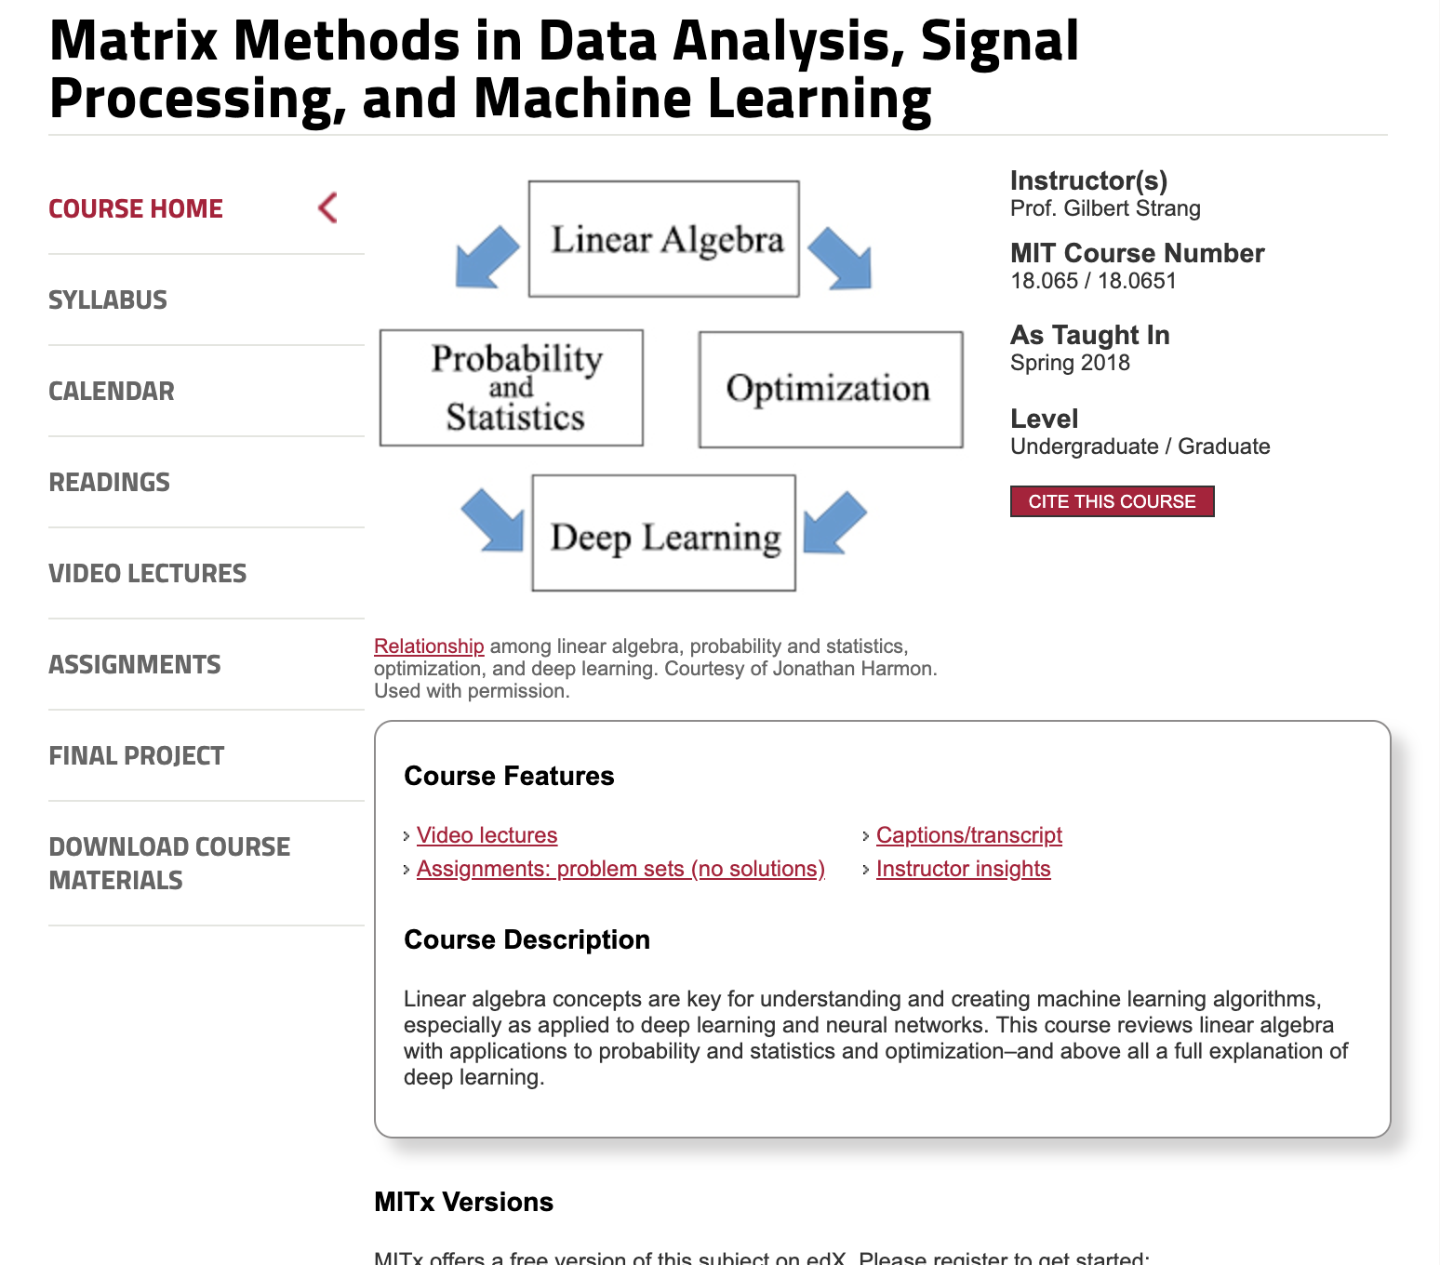
Site:

Slide 3
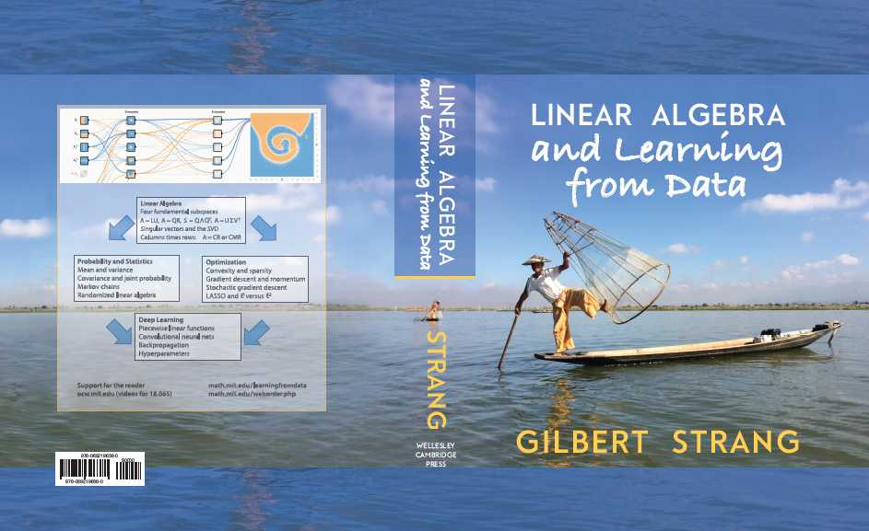
textbook

Slide 4

Course Introduction of 18.065 by Professor Strang

Slide 5
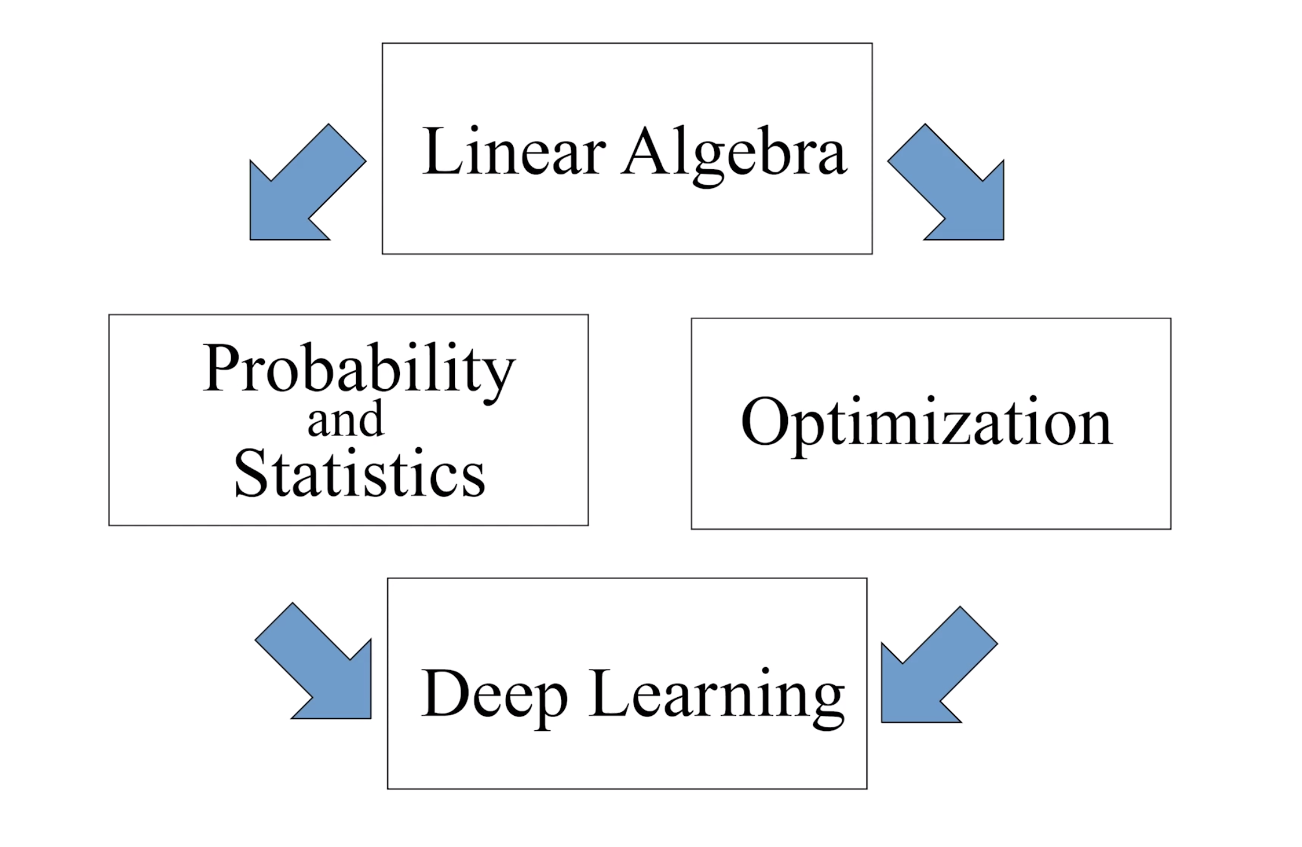
Topics
Notes:
Evaluation of the two extremes cases

Slide 6
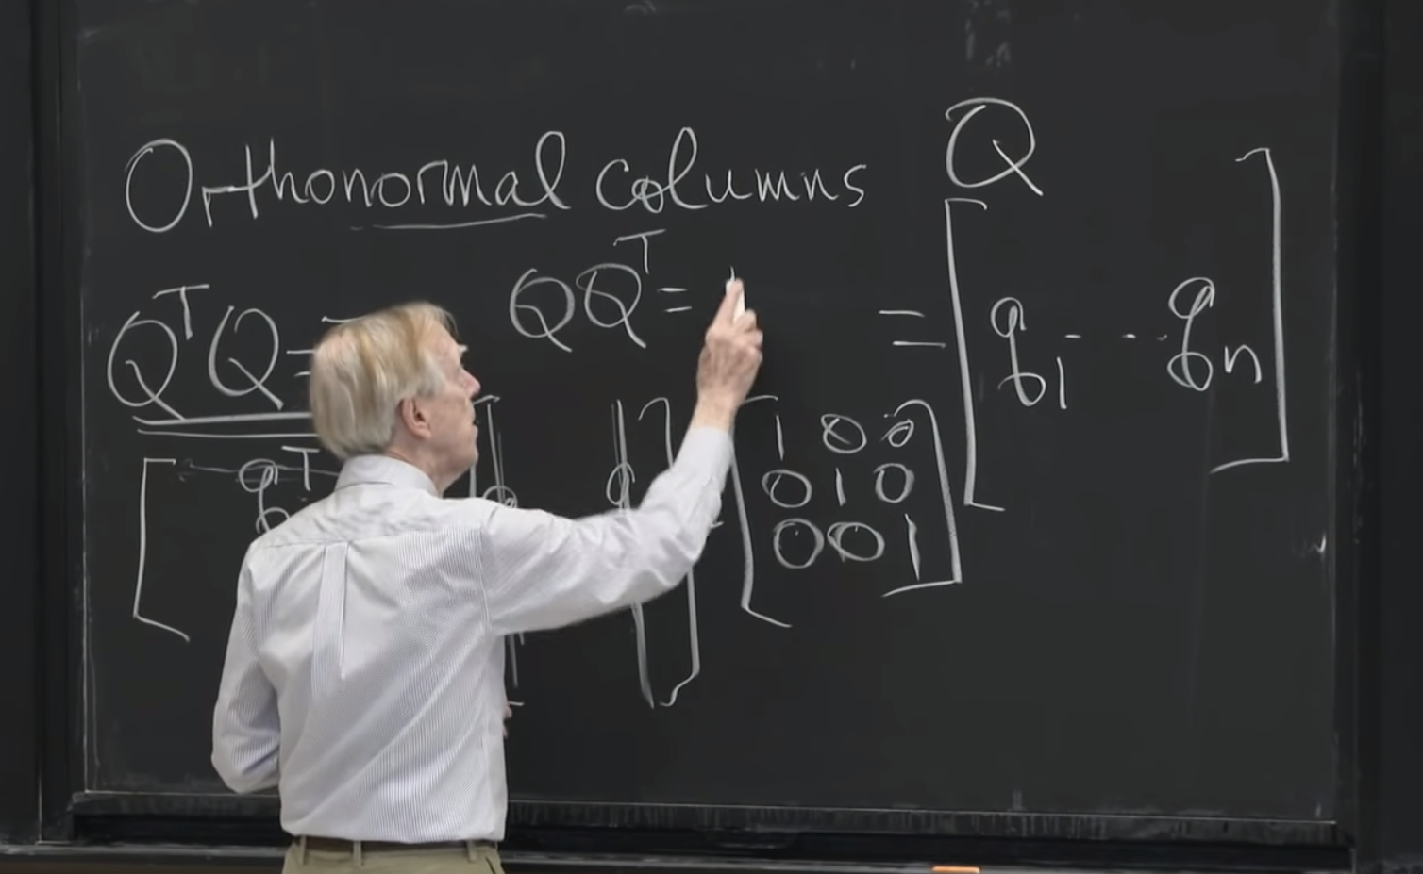
Linear Algebra
Symmetric Matrices
Othogonal Matrices
Single Value Decomposition (SVD)
Notes:
Evaluation of the two extremes cases

Slide 7
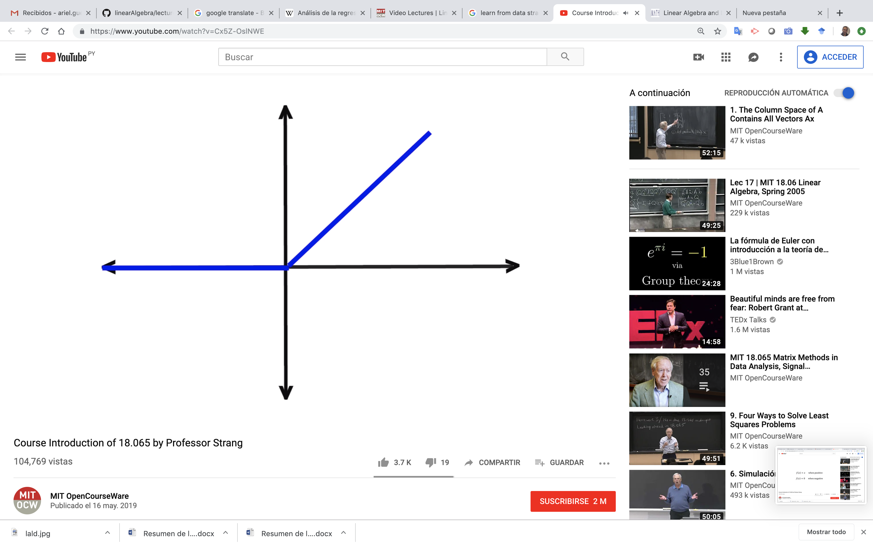
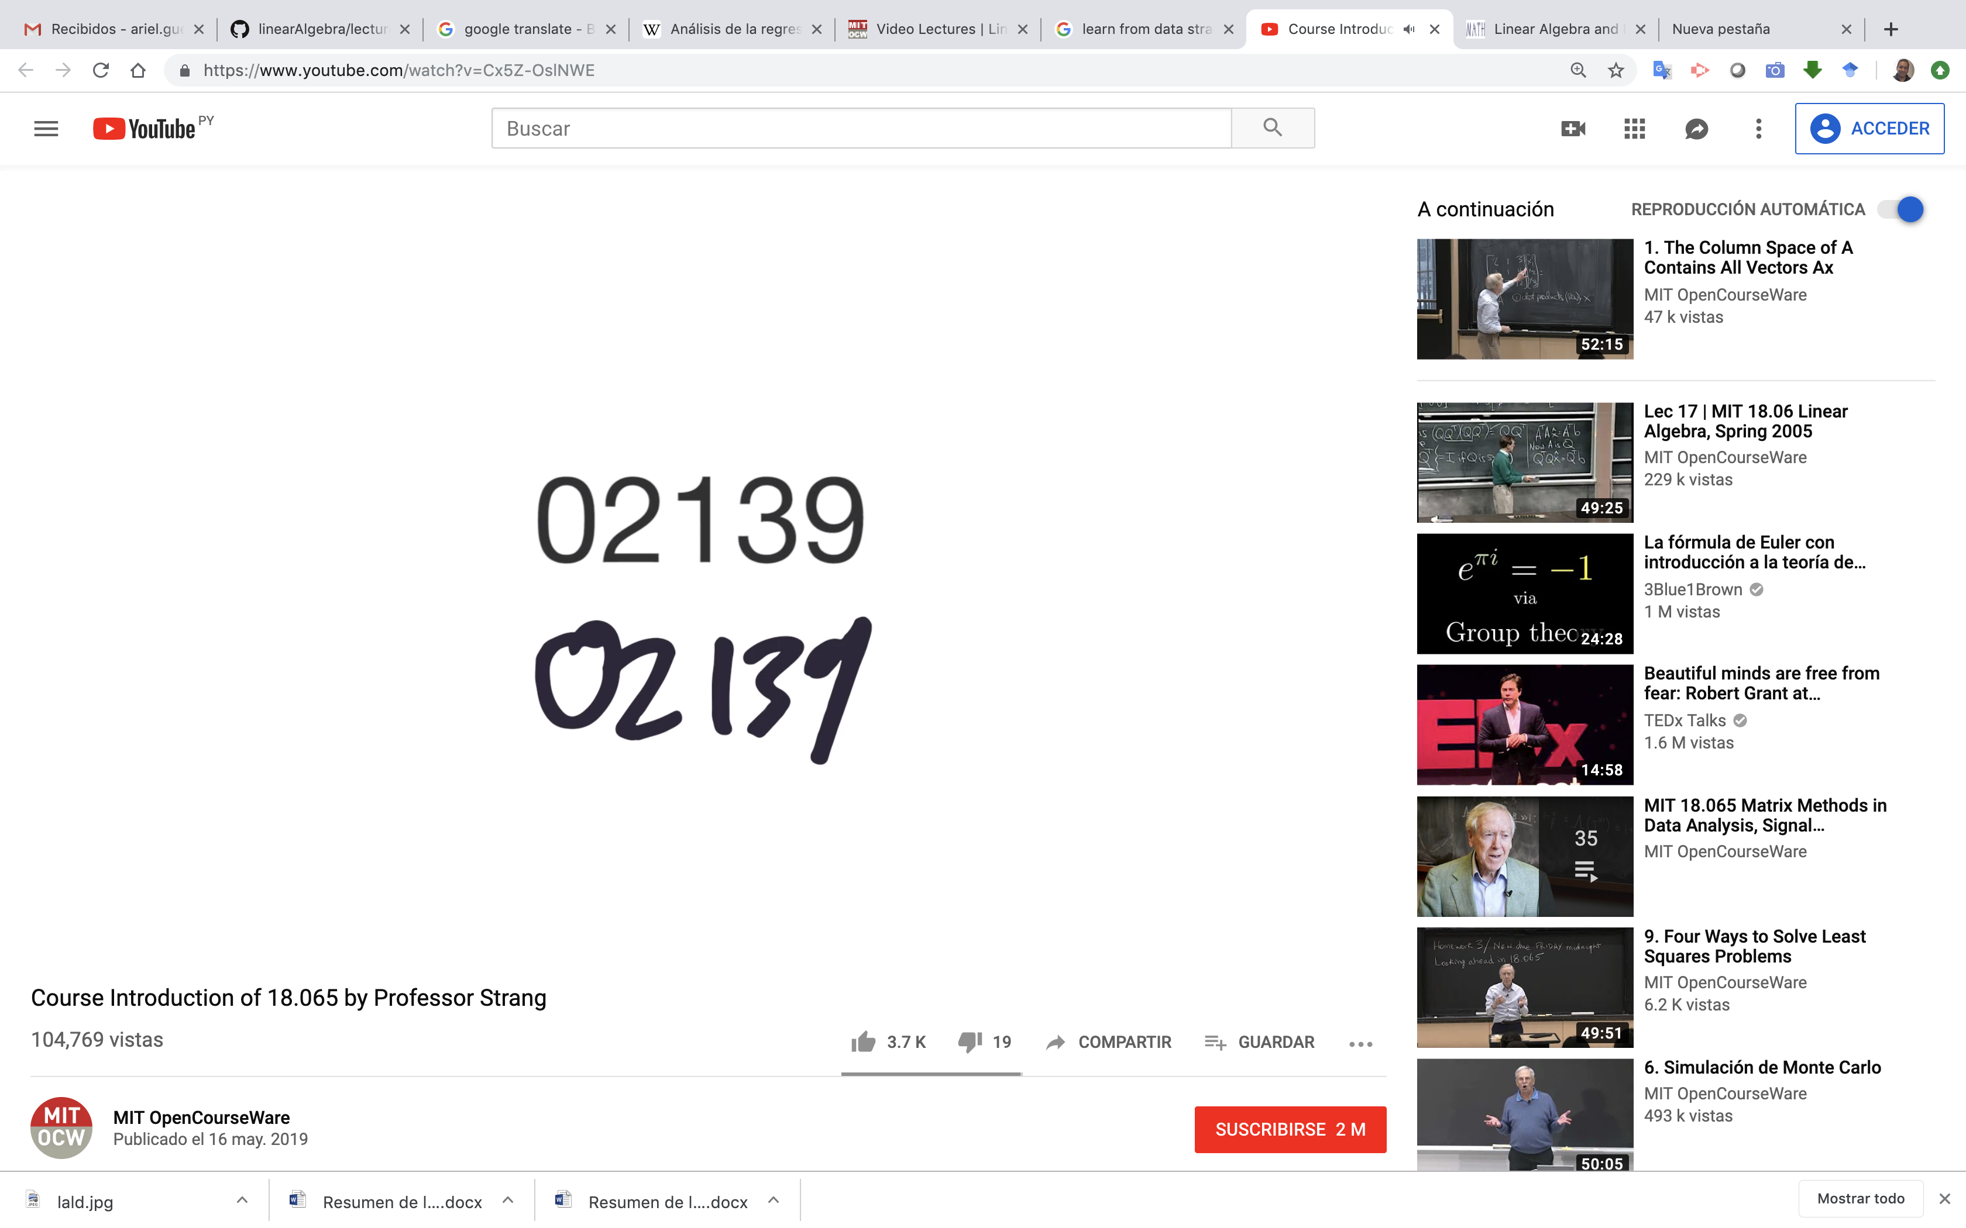


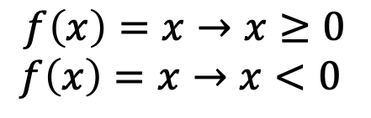
Deep learning
$$f\left(x\right)=x→x≥0$$
$$f\left(x\right)=x→x<0$$

Slide 8
Credits
https://github.com/aegiloru/lald
https://ocw.mit.edu/courses/mathematics/18-065-matrix-methods-in-data-analysis-signal-processing-and-machine-learning-spring-2018/index.htm
Gilbert Strang Web Site
http://www-math.mit.edu/~gs/
http://math.mit.edu/~gs/learningfromdata/

